Slide 1
Bat-Inspired Algorithm

Slide 2
Metaheuristic Bat-Inspired Algorithm
In 2010, Xin-SheYang proposed BA
based on swarm intelligence and
the inspiration from observing the bats
Three major characteristics of the micro-bat
echolocation behavior
the frequency with a variable wavelength λ
the loudness A₀ to search for prey.

Slide 3
4.1.The characteristics of micro-bat
Bats fly randomly with
velocity v_{i} at position x_{i} .
They can
adjust the wavelength (or frequency) of their emitted pulses and
adjust the rate of pulse emission r ∈ [0, 1], depending on the proximity of their target;
Ways to adjust the loudness
For simplicity, the loudness is assumed to be varied from
a positive large A₀ to a minimum constant value,
which is denoted by A_{min}

Slide 4
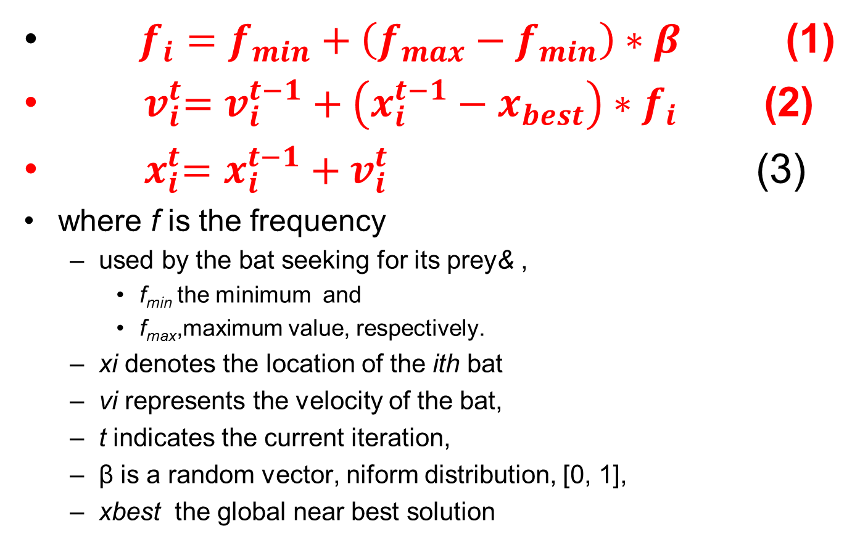
4.1. Formulators
$f_{i}=f_{min}+\left(f_{max}−f_{min}\right)∗β$ (1)
${ v}_{i}^{t}=v_{i}^{t−1}+\left(x_{i}^{t−1}−x_{best}\right)∗f_{i}$ (2)
${ x}_{i}^{t}=x_{i}^{t−1}+v_{i}^{t}$ (3)
where f is the frequency
used by the bat seeking for its prey& ,
f_{min} the minimum and
f_{max},maximum value, respectively.
xi denotes the location of the ith bat
vi represents the velocity of the bat,
t indicates the current iteration,
β is a random vector, niform distribution, [0, 1],
xbest the global near best solution

Slide 5
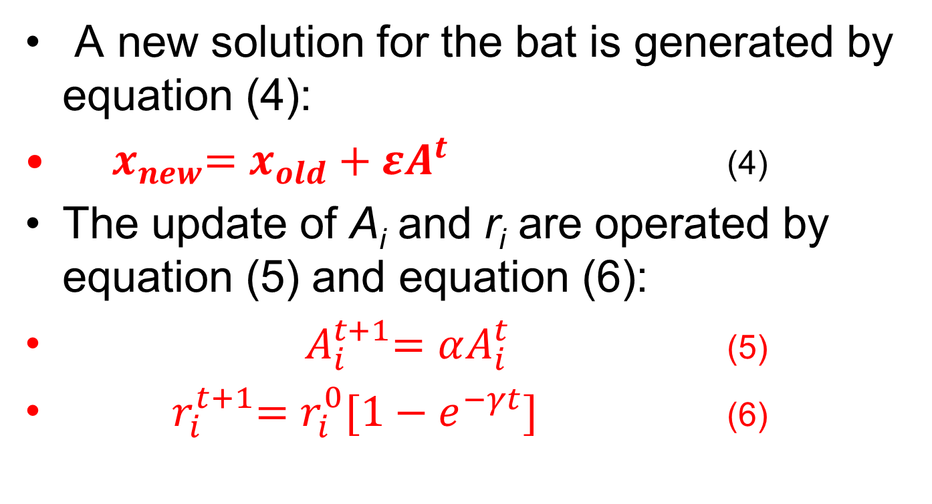
Formulators
A new solution for the bat is generated by equation (4):
${ x}_{new}=x_{old}+εA^{t}$ (4)
The update of A_{i} and r_{i} are operated by equation (5) and equation (6):
${ A}_{i}^{t+1}=αA_{i}^{t}$ (5)
${ r}_{i}^{t+1}=r_{i}^{0}[1−e^{−γt}]$ (6)

Slide 6
The process of Bat Algorithm
Step 1. Initialize the bat population, the pulse rates, the loudness, and define the pulse frequency
Step 2. Update the velocities to update the location of the bats, and decide whether detonate the random walk process.
Step 3. Rank the bats according to their fitness value, find the current near best solution found so far, and then update the loudness and the emission rate.
Step 4. Check the termination condition to decide whether go back to step 2 or end the process and output the result

